Slide 1
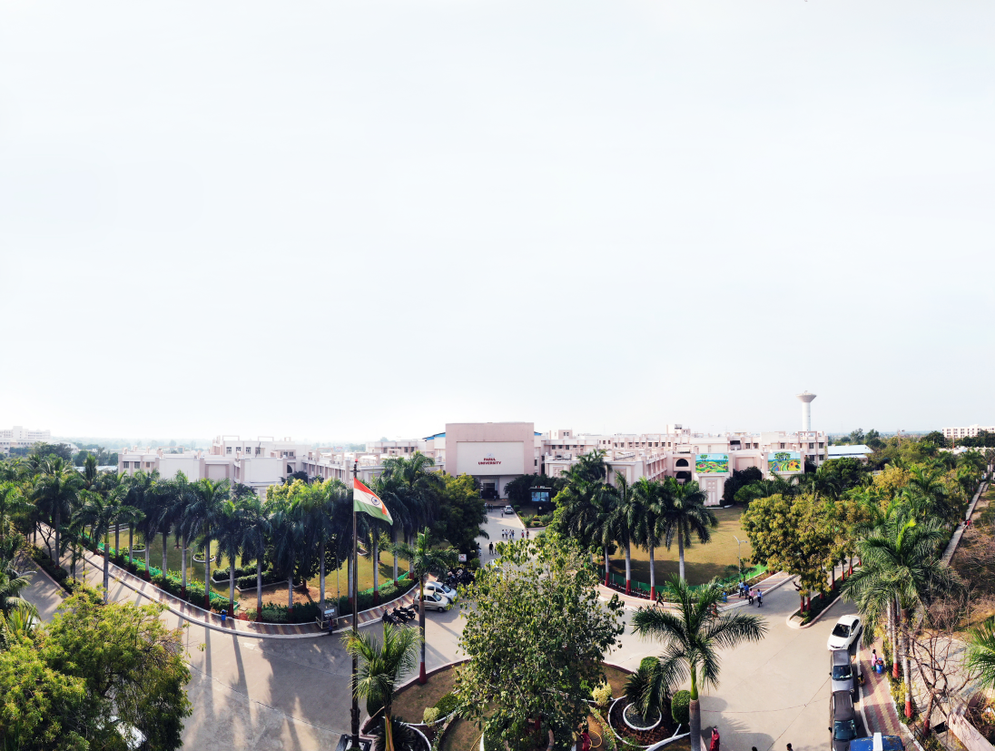


Object Oriented Concepts with UML
203105207
Prof. Shaleen Shukla, Assistant Professor
Information Technology Department

Slide 2
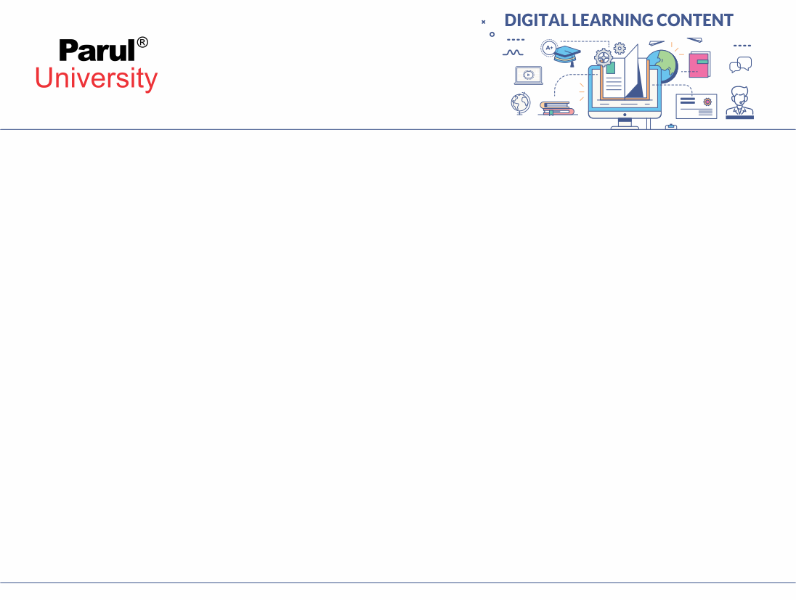

Interaction Models
The class model describes the class & objects in a system and their relationship.
The state model describes the life cycles of the objects.
The interaction model describes how the objects interact.
The interaction model starts with use cases that are then elaborated with sequence and activity diagrams

Slide 3
Interaction Models
Use case: focuses on functionality of a system- i.e, what a system does for users
Sequence diagrams: shows the object that interact and the time sequence of their interactions
Activity diagrams: elaborates important processing steps

Slide 4
CHAPTER-3
Use Case Models

Slide 5
Introduction
Use cases are description of the functionality of a system from user perspective.
It shows the relationships between the actors(Users) that use the system, the use cases(functionalities) they use and the relationships between different use cases.

Slide 6
Use Case Diagrams
Use Case diagrams show the various activities the users can perform on the system.
System is something that performs a function.
They model the dynamic aspects of the system.
Provides a user’s perspective of the system

Slide 7
Use-Case Diagrams
A use case is a model of the interaction between External users of a software product (actors) and The software product itself
More precisely, an actor is a user playing a specific role describing a set of user scenarios capturing user requirements contract between end user and software developers

Slide 8
Using Use Case Diagrams
Use case diagrams are used to visualize, specify, construct, and document the (intended) behavior of the system, during requirements capture and analysis.
Provide a way for developers, domain experts and end-users to Communicate.
Serve as basis for testing.
Use case diagrams contain use cases, actors, and their relationships.

Slide 9
Use-Case Diagrams
Actor: A role that a user plays with respect to the system, including human users and other systems. e.g., inanimate physical objects (e.g. robot); an external system that needs some information from the current system.
Use case: A set of scenarios that describing an interaction between a user and a system, including alternatives.
System boundary: rectangle diagram representing the boundary between the actors and the system.
Association: Communication between an actor and a use case; Represented by a solid line.

Slide 10
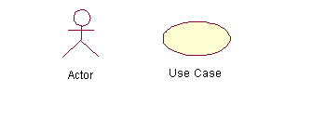
Use-Case Diagrams

Slide 11
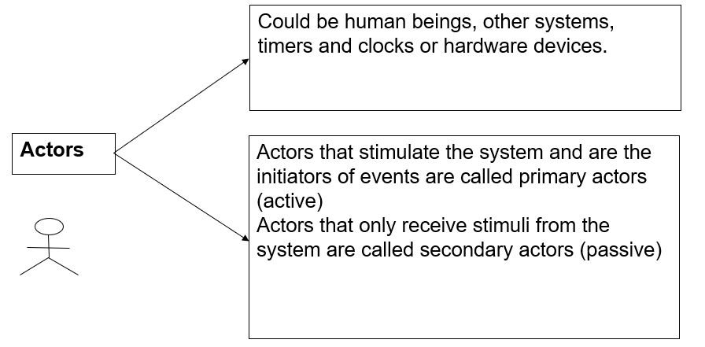
Actors

Slide 12
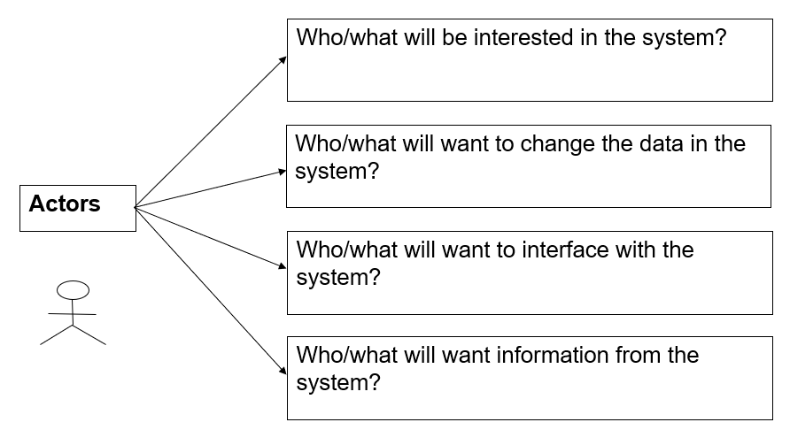
Actors

Slide 13
Use Case Diagram– Guidelines & Caution
Avoid showing communication between actors.
Actors should be named as singular. i.e student and NOT students. NO names should be used – i.e John, Sam, etc.

Slide 14
Use-Case Diagrams: Actors and Goals
Start by identifying the actors of the system
Define the goals of the system and how they can be achieved using the systems’ actors
Illustrate these goals and actors actions using use-case diagram(s)

Slide 15
Use-case Diagram: Use-case
A use case describes a sequence of actions a system performs to yield an observable result or value to a particular actor
Naming convention = verb + noun (or) verb + noun-phrase,
e.g. withdraw cash
A good use case should:
Describe a sequence of transactions performed by a system that produces a measurable result (goal) for a particular actor
Describe the behavior expected of a system from a user's perspective
Enable the system analyst to understand and model a system from a high-level business viewpoint
Represent the interfaces that a system makes visible to the external entities and the interrelationships between the actors and the system

Slide 16
Use Case Diagrams – Use Cases
Use case is a particular activity a user can do on the system.
Is represented by an ellipse.
Following are two use cases for a library system.
Borrow
Reserve

Slide 17
Identifying use cases for a system
What are the tasks of each actor?
Will any actor create, store, change, remove, or read the information?
Will any actor need to inform the system about the sudden, external changes?
Does any actor need to informed about certain occurrences in the system?
What use cases will support and maintain the system?
Can all functional requirements be performed by the use cases?

Slide 18
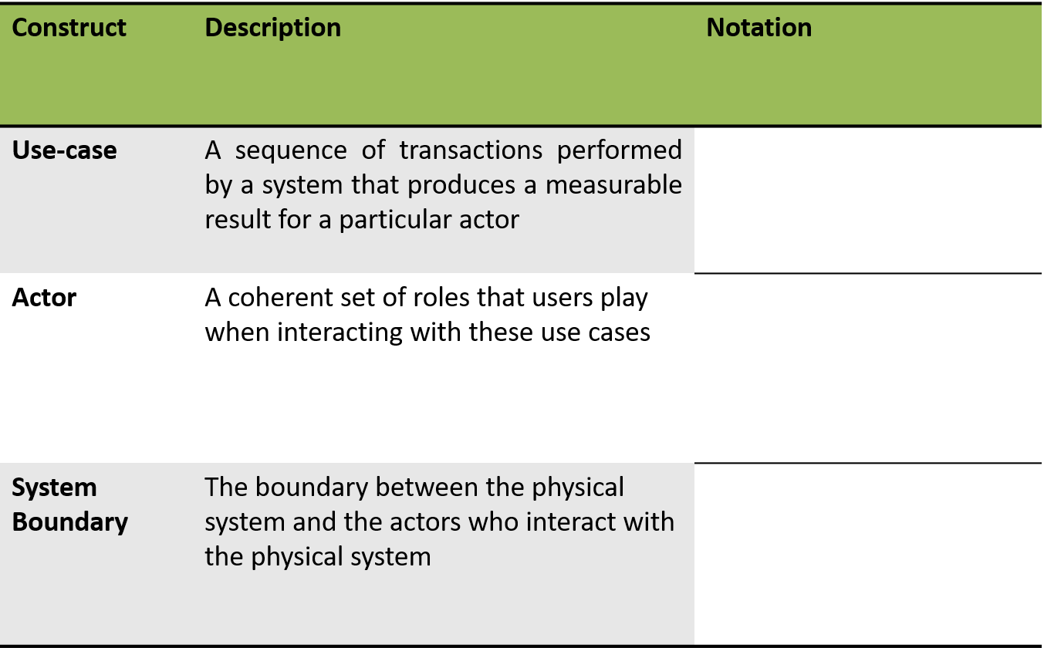
Summary of Notations

Slide 19
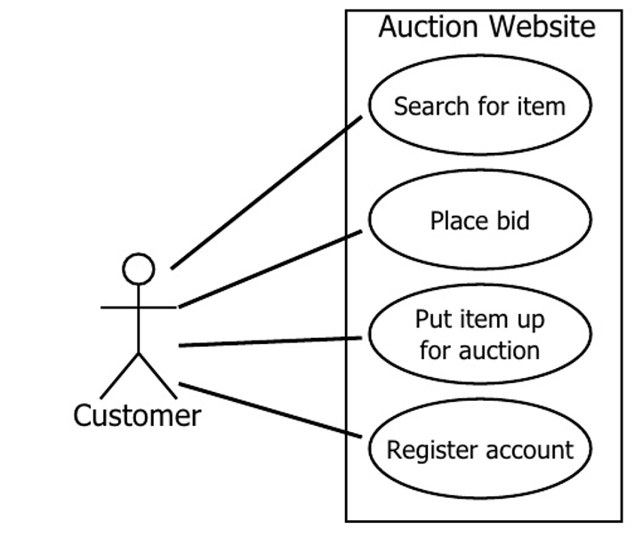
Auction Website Use Cases

Slide 20
Use cases
Functionality provided by the system
Consist of a series of steps which collectively add value to the user of the system
Examples
Issue a book to a member
Receive a book back from a member
Query the current location of a book
Maintain member’s information
Maintain book’s information

Slide 21
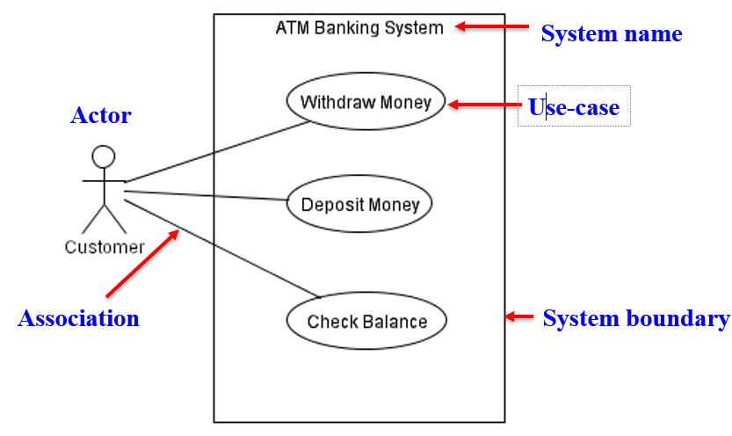
Use-Case Diagram: Example

Slide 22
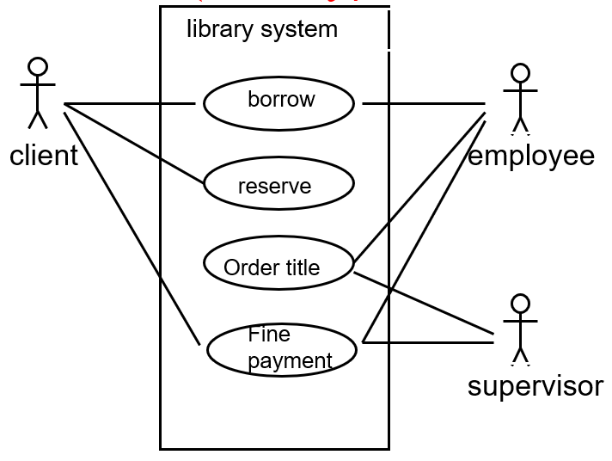
Use Case Diagram – Example1 (Library)

Slide 23
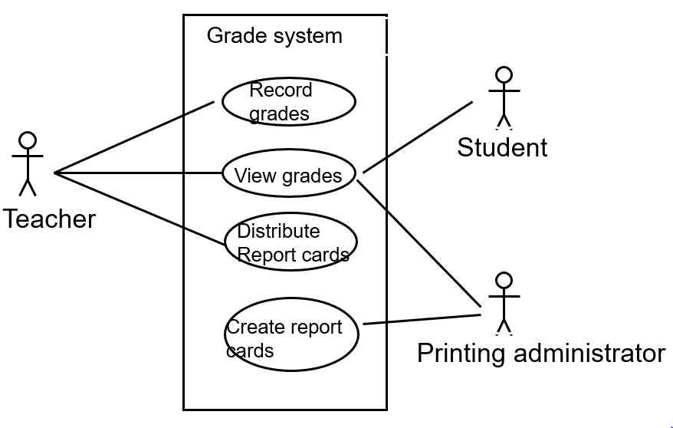
Use Case Diagram for Student Assessment Management System

Slide 24
Use-Case Diagrams
Include: a dotted line labeled <<include>> beginning at base use case and ending with an arrows pointing to the include use case. The include relationship occurs when a chunk of behavior is similar across more than one use case. Use “include” in stead of copying the description of that behavior.
Extend: a dotted line labeled <<extend>> with an arrow toward the base case. The extending use case may add behavior to the base use case. The base class declares “extension points”.

Slide 25
Include
base
<<include>>
included
The base use case explicitly incorporates the behavior of another use case at a location specified in the base.
The included use case never stands alone. It only occurs as a part of some larger base that includes it.

Slide 26
More about Include
Enables to avoid describing the same flow of events several times by putting the common behavior in a use case of its own.
updating
grades
<<include>>
verifying
student id
output
generating
<<include>>

Slide 27
The <<include>> Relationship
Include relationships are used when two or more use cases share some common portion in a flow of events
This common portion is then grouped and extracted to form an inclusion use case for sharing among two or more use cases
Most use cases in the ATM system example, such as Withdraw Money, Deposit Money or Check Balance, share the inclusion use-case Login Account

Slide 28
Extend
The base use case implicitly incorporates the behavior of another use case at certain points called extension points.
The base use case may stand alone, but under certain conditions its behavior may be extended by the behavior of another use case.
base
<<extend>>
extending

Slide 29
The <<extend>> Relationship
In UML modeling, you can use an extend relationship to specify that one use case (extension) extends the behavior of another use case (base)
This type of relationship reveals details about a system or application that are typically hidden in a use case

Slide 30
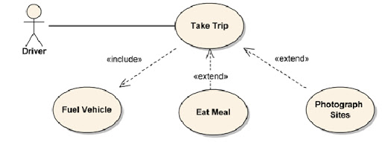
The <<extend>> Relationship

Slide 31
Sequence Models

Slide 32
Sequence Diagrams
Sequence diagrams, also known as event diagrams or event scenarios, illustrate how processes interact with each other by showing calls between different objects in a sequence.
These diagrams have two dimensions:
The vertical lines show the sequence of messages and calls in chronological order
Horizontal elements show object instances where the messages are relayed.

Slide 33
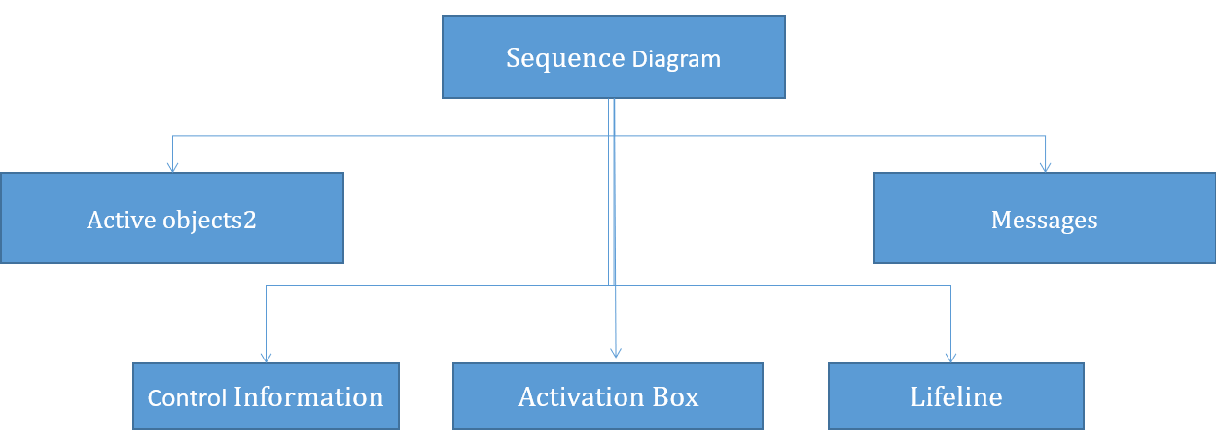
Sequence Diagram

Slide 34
SEQUENCE DIAGRAM (Important Components)
Active Objects:
Any objects that play a role in the system
Can be any object or class that is valid within the system
Can be an Actor that is external to the system and derives benefits from the system
Messages:
Used to illustrate communication between different active objects.
Used when an object needs
To activate a process of a different object
To give information to another object

Slide 35
SEQUENCE DIAGRAM (other Components)
Lifeline
Denotes the life of actors/objects over time during a sequence
Focus of control (activation box)
Means the object is active and using resources during that time period
Control information
Shows the control flow in the system
Creation and destruction of an object through <<create>> and <<destroy>>

Slide 36
Representing Objects
Squares with object type, optionally preceded by object name and colon
Write object's name if it clarifies the diagram
Object's "life line" represented by dashed vertical line

Slide 37
Representing Objects

Slide 38
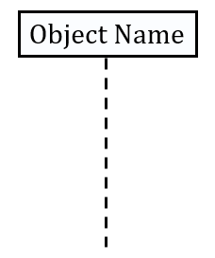
Lifeline
Objects are displayed at the top of the diagram
The vertical dimension represents time
Each object has a dashed line – lifeline – extending below it – to indicate the period of time during which objects playing that role actually exist

Slide 39
Lifetime of objects
Creation: An arrow with 'new' written above it
Deletion: An X at bottom of object's lifeline

Slide 40
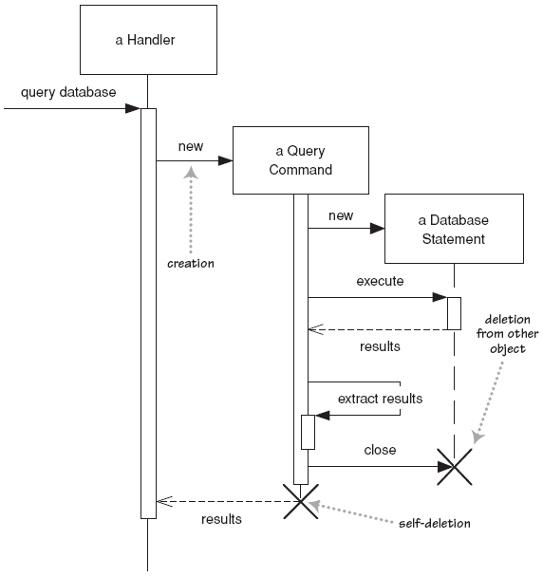
Lifetime of objects

Slide 41
Message
The messages in an interaction are drawn from top to bottom, in the order that they are sent.
Messages are shown as arrows pointing from the lifeline of the role sending the message to the lifeline of the receiver.
When a message is sent, control passes from the sender of the message to the receiver.

Slide 42
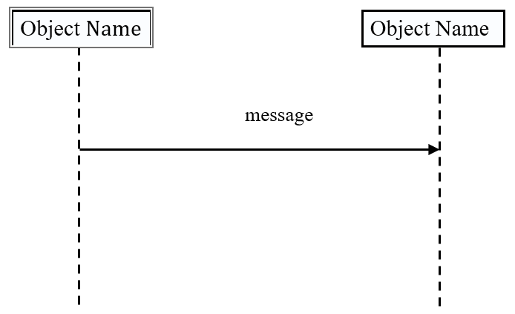
Message

Slide 43
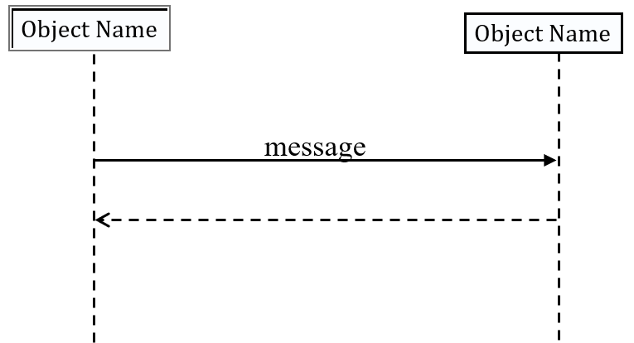
Return
Return of control is shown using dashed arrow returning to the calling object.

Slide 44
Messages between Objects
Message (method call) indicated by horizontal arrow to other object
Write message name and arguments above arrow

Slide 45
Indicating method calls
Activations - show when a method is active – either executing or waiting for a subroutine to return
Either that object is running its code, or it is on the stack waiting for another object's method to finish

Slide 46
Activation
Period of time during which an object is processing a message, Shown on a lifeline as a narrow rectangle whose top is connected to a message.
When an object finishes processing a message, control returns to the sender of the message

Slide 47
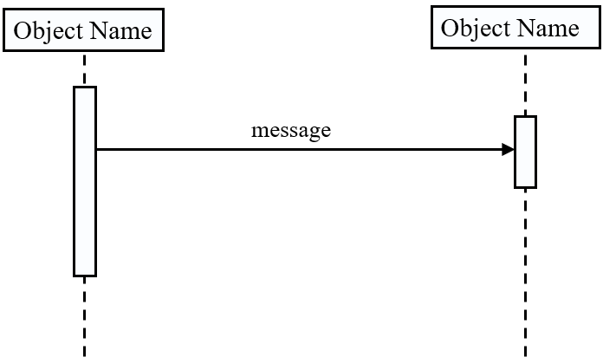
Activation

Slide 48
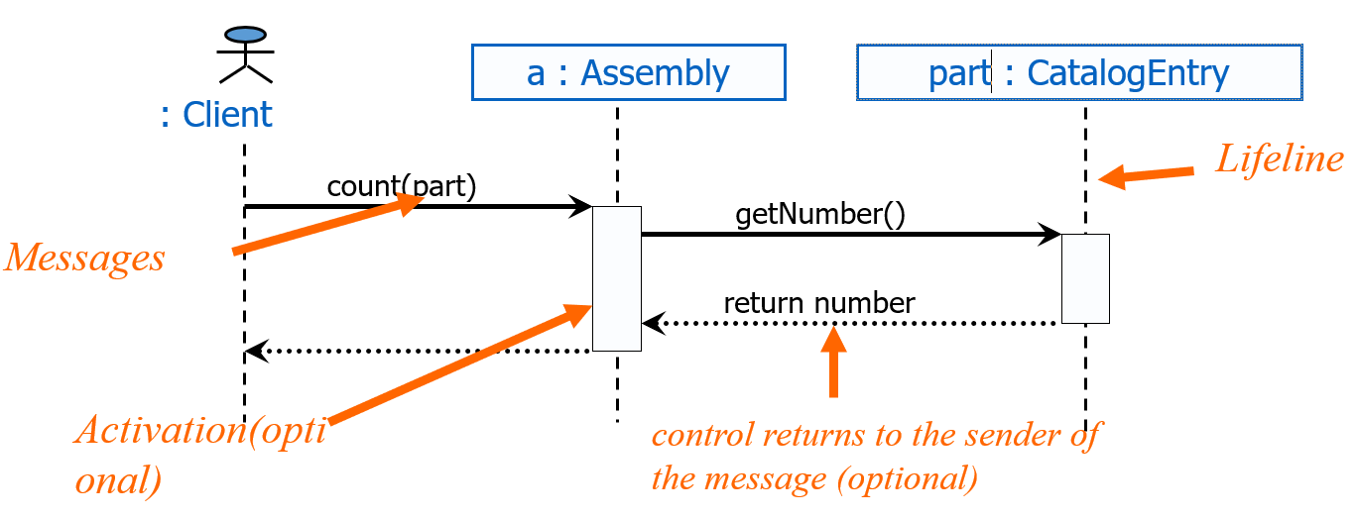
Sequence Diagram

Slide 49
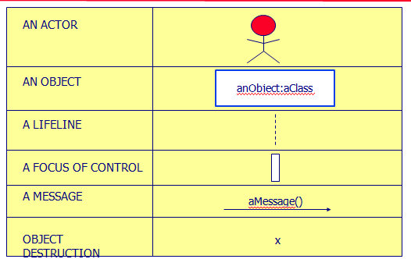
Sequence Diagram Syntax

Slide 50
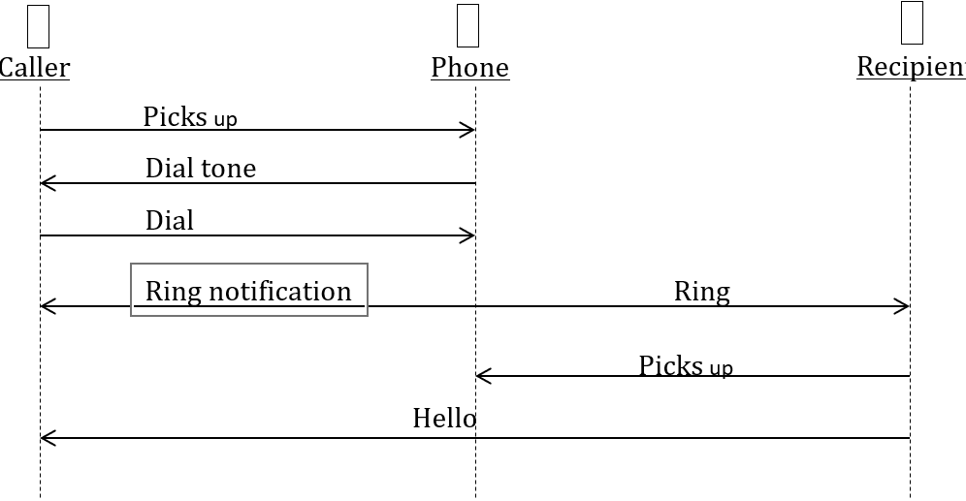
Sequence Diagram(make a phone call)

Slide 51
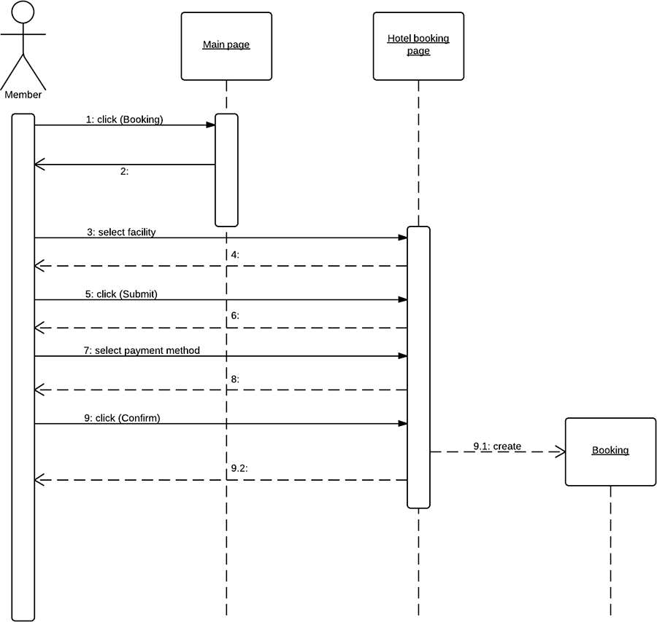
Activation
Period of time during which an object is processing a message, Shown on a lifeline as a narrow rectangle whose top is connected to a message.
When an object finishes processing a message, control returns to the sender of the message

Slide 52
Activity Models

Slide 53
What Is an Activity Diagram?
Activity diagrams and use cases are logical model which describe the business domain’s activities without suggesting how they are conduct.
Shows the sequence of steps that make up a complex process.
Shows flow of control, similarly sequence diagram but focus on operations.
A diagram that emphasizes the flow of control from activity to activity in an object.
Similar to the traditional program flowchart.
Used to provide detail for complex algorithms.
Primary activities and the relationships among the activities in a process.

Slide 54
Drawing Activity Diagrams
Purpose
to model a task (for example in business modelling)
to describe a function of a system represented by a use case
to describe the logic of an operation
to model the activities that make up the life cycle in the Unified Process

Slide 55
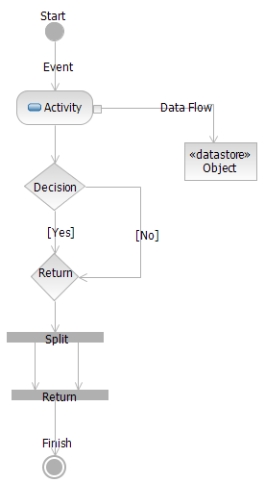
The Activity Diagram Components
Initial Node
Control Flow
Action or Activity
Object Flow
Branch
Merge
Fork
Join
Final Node

Slide 56

Initial Node
This represents the start of the flow of an activity diagram.
An activity diagram contains a single start node.
The name of the initial node is entered on the node. It takes the form of an adjective.

Slide 57

Control Flow
A control flow connects any combination of:
activities branches merges forks joins
A control flow has direction, which is indicated by the arrow head – you may only traverse the control flow in the direction of the arrow.
A control flow may not enter an initial state.
A control flow may not exit a final node.
A control flow is the representation of an occurrence of an event.
The name of the event is entered on the control flow. It takes the form of something has been done, noun-verb(past-tense)

Slide 58

Activity And Action
The activity represents the actions that occur as a result of an incoming event from a control flow.
The name of the activity is entered on the activity and takes the form of something being done, present tense verb-nounj

Slide 59
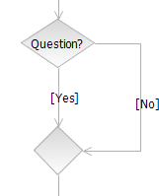
Branch
The branch is used to show alternative paths in the activity diagram.
Label the decision node with a question(?).
Do not label the merge,
(unless you have a good reason to).
One control flow enters the decision node and two or more alternative control flows exit the decision node.
Only one of the paths may be transitioned as the result of an event occurring.
Each exiting control flow contains the condition under which it is taken (called a guard), dependent upon the answer to the question. These guards must be mutually exclusive.

Slide 60
Branch
The guards on exiting control flows must cover all possible outcomes of the question being asked by the branch.
The simplest way to ensure all possible outcomes are covered is to phrase the branch question such that the only possible answers are ‘Yes’ or ‘No’. Note, this can add extra branches to the diagram.
Two or more control flows enter the merge node and one control flow exits.

Slide 61
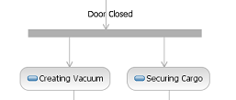
Fork
The fork may be represented by vertical or horizontal bars.
The fork represents that the flow through the diagram has split into 2 paths that are running in parallel (multitasking).
The fork has a single control flow on entry and several control flows exiting.
Use a fork when there is no requirement on the order of activities in a flow.
For example, the DE materializer receives an event that the door is shut. It now suspends the cargo and creates a vacuum, but these actions may be performed in parallel, so we model them with a fork.

Slide 62
Join
For every fork there should be a join (if not your activity diagram is broken).
The join may be represented by vertical or horizontal bars.
A join simply shows that when the parallel activities have finished that they then come back to join a single flow again.
The join has several control flows entering and a single control flow on exit.
The exiting control flow cannot be executed until every incoming control flow has completed.
There is no need to label the fork or join.

Slide 63

Final Node
The final node represents the termination of the activity diagram.
There may be several termination states in a single diagram.
Label the final node with an adjective.

Slide 64
Let’s review the shapes

Slide 65
START POINT
DECISION POINT
END POINT
[Condition]
GUARD
STEP
PARALLEL STEPS
For each X:
REPEATED STEPS
TRANSITION

Slide 66
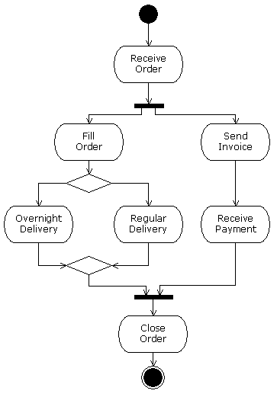

Slide 67
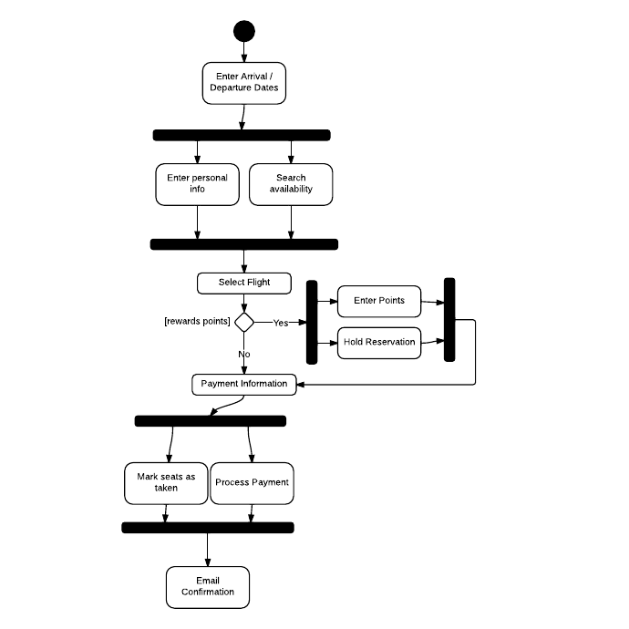

Slide 68
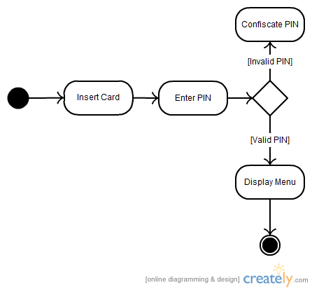

Slide 69
START POINT

Slide 70
The Start Point represents the EVENT that triggers the use case.

Slide 71
Actor elects to Add Customer
END POINT

Slide 72
Actor elects to Add Customer
Label the End Point to EXPLICITLY confirm that the intent of the use case has been achieved.

Slide 73
Actor elects to Add Customer
Customer added

Slide 74
Actor elects to Add Customer
This makes it clear to the reader that the use case is complete and that nothing further is needed in order to fulfil the intent.
Customer added

Slide 75
Actor elects to Add Customer
End of process

Slide 76
Actor elects to Add Customer
To reach the End Point…
End of process

Slide 77
… you need to model STEPS.

Slide 78
Link the steps with TRANSITIONS.

Slide 80
Transitions use arrow heads to show the direction of process flow.

Slide 81
I like to put a note against any step that achieves the goal of the use case.
Goal X achieved

Slide 82
Goal X achieved
… because it might not be the last step.

Slide 83
Often in a use case the System has to make a decision based on business rules...

Slide 84
The actual decision takes place within a STEP

Slide 85
System determines whether X or Y
The actual decision takes place within a STEP

Slide 86
A DECISION POINT is then used to help the reader navigate the diagram.
System determines whether X or Y

Slide 87
DECISION POINT

Slide 88
Decision Points contain text which describes the nature of the decision to be made.

Slide 89
So was it X or Y?

Slide 90
Decision points allow the flow to branch away from the Primary Path.

Slide 91
Transitions coming out of Decision Points must have a GUARD.
[Condition 2]
[Condition 1]

Slide 92
A Guard needs to explicitly describe a condition which must be true in order to proceed down that path.
[IT WAS “Y”]
[IT WAS “X”]

Slide 93
If the flow rejoins the Primary Path, it is known as an Alternate Path.
[Condition 2]
[Condition 1]

Slide 94
You can show how paths rejoin by using a MERGE POINT.
[Condition 1]
[Condition 2]

Slide 95
You can show how paths rejoin by using a MERGE POINT.
[Condition 1]
[Condition 2]

Slide 96
I prefer to model merging paths like this.
[Condition 1]
[Condition 2]

Slide 97


www.paruluniversity.ac.in

